Slide 1
Gradient Descent
Instructor: Mohammad Hasan
Office: 13-240
09/23/26
Notes:
Welcome and Introductions

Slide 2
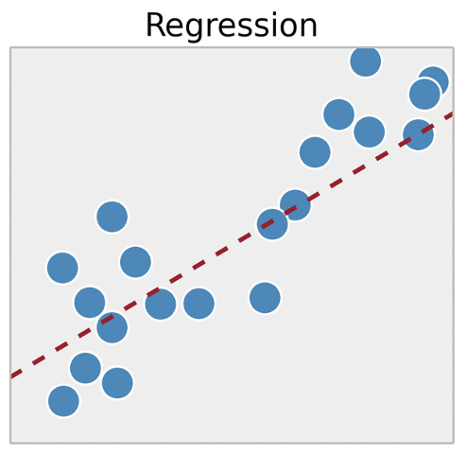
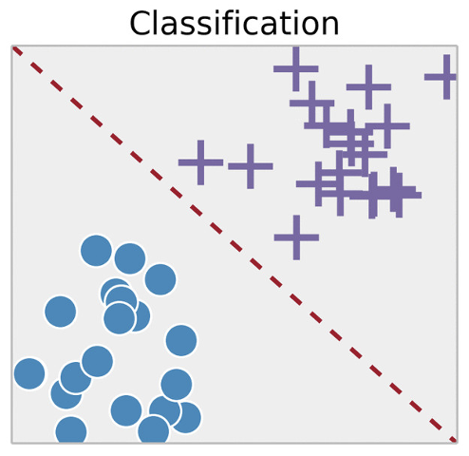


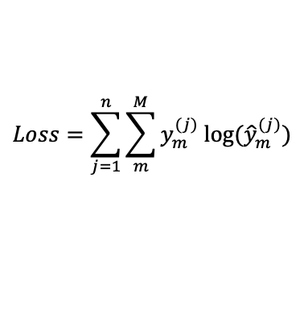
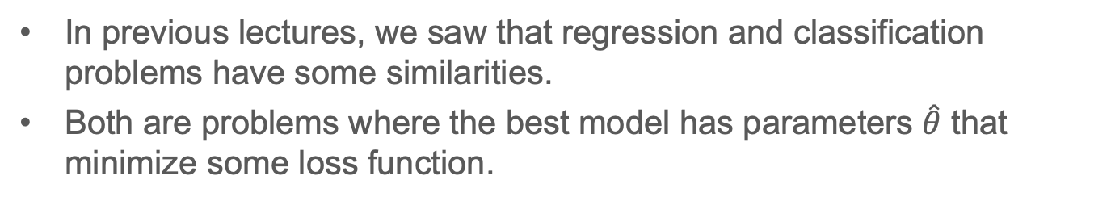
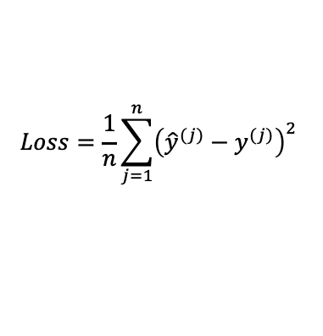
Motivation
In previous lectures, we saw that regression and classification problems have some similarities.
Both are problems where the best model has parameters $\hat{θ}$ that minimize some loss function.
Mean square error
Linear Regression: closed form solution
$$Loss=\frac{1}{n}\sum_{j=1}^{n}{{\left({\hat{y}}^{(j)}−y^{(j)}\right)}^{2}}$$
$$\hat{θ}={\left(X^{T}X\right)}^{−1}X^{T}Y$$
$$\hat{θ}=argmin_{θ}\left(Loss\right)$$
Categorical cross-entropy
Logistic Regression: No closed form solution
$$Loss=\sum_{j=1}^{n}{\sum_{m}^{M}{y_{m}^{(j)} log⁡({\hat{y}}_{m}^{(j)})}}$$

Slide 3
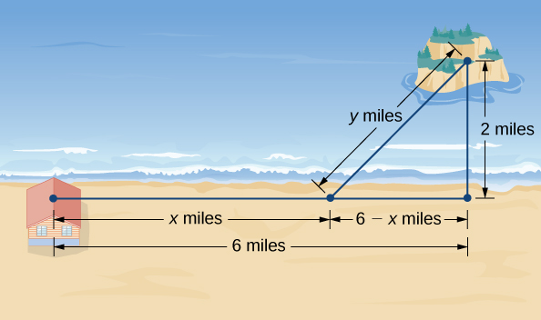
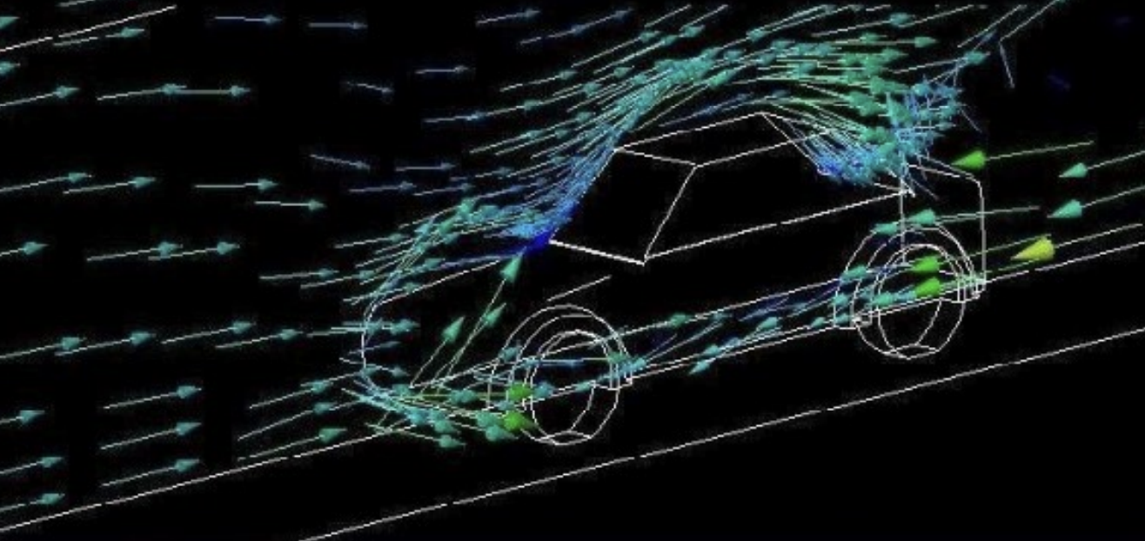
Optimization Problems
Optimization problems:
A type of problem that aims to find optimal parameters that:
Minimizes a cost (or loss) function
OR maximizes an objective function
Reduce trip time
Reduce drag coefficient
Reduce aggregate error (loss function)

Slide 4
Overview
Optimization introduction
Single variate and multivariate optimization
Gradient Descent (BGD vs SGD)
Convex and non-convex optimization

Slide 5


A Way to the Solution
Suppose our machine learning model is a function of 1 parameter $θ$:
$$\hat{y}=f\left(\vec{x}, θ\right)$$
We may want to look at the the relationship between the loss function and the parameter:

Slide 6









The Sense of Down

Slide 7


Observations

Slide 8





Gradient Descent
In reality, most machine learning models have many parameters. Tens, hundreds … billions sometimes.
We can expand this method provided to handle multiple parameters:

Slide 9



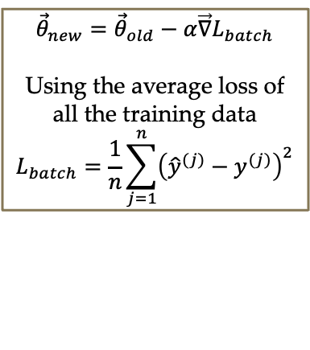
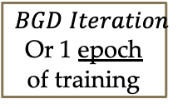



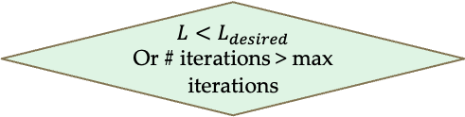
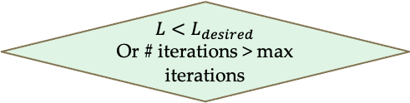
Batch Gradient Descent and Stochastic Gradient Descent
In reality, there are multiple versions of gradient descent.
Batch Gradient Descent BGD
Stochastic Gradient Descent SGD
$$BGD Iteration$$
Or 1 epoch of training
Initialize $\vec{θ}$
Initialize $\vec{θ}$
$${\vec{θ}}_{new}={\vec{θ}}_{old}−α\vec{∇}L_{batch}$$
Using the average loss of all the training data
$$L_{batch}=\frac{1}{n}\sum_{j=1}^{n}{{\left({\hat{y}}^{(j)}−y^{(j)}\right)}^{2}}$$
S$GD Iteration$
$${\vec{θ}}_{new}={\vec{θ}}_{old}−α\vec{∇}L$$
Using one datapoint
$$L={\left({\hat{y}}^{(j)}−y^{(j)}\right)}^{2}$$
No
Yes
No
Yes
$$L<L_{desired}$$
Or # iterations > max iterations
$$L<L_{desired}$$
Or # iterations > max iterations
Optimized $\vec{θ}$
Optimized $\vec{θ}$
Note: often, instead of a single training datapoint, SGD uses a small batch of training data called a “mini-batch”

Slide 10


Gradient Calculation for Multivariate Linear Regression
$L={\left({\hat{y}}^{\left(j\right)}−y^{\left(j\right)}\right)}^{2}={\left(θ_{0}+θ_{1}x_{1}^{(j)}+…+θ_{N}x_{N}^{\left(j\right)}−y^{(j)}\right)}^{2}$
For some arbitrary parameter associated with feature $i$:
$\frac{∂L}{∂θ_{i}}=2\left(θ_{0}+θ_{1}x_{1}^{(j)}+…+θ_{N}x_{N}^{\left(j\right)}−y^{(j)}\right) \left(x_{i}^{(j)}\right)$ [Applying the chain rule]
Thus, the gradient equals:
$\vec{∇}L=2\left(θ_{0}+θ_{1}x_{1}^{(j)}+…+θ_{N}x_{N}^{\left(j\right)}−y^{(j)}\right){\vec{x}}^{∗(j)}$
This error is often called the “residual”, which we can store and use later
Then $\vec{∇}L=2∗residual∗{\vec{x}}^{∗(j)}$
Note: ${\vec{x}}^{∗(j)}$ is an augmented input with a 1 in the first row (so we can deal with the bias $θ_{0}$

Slide 11
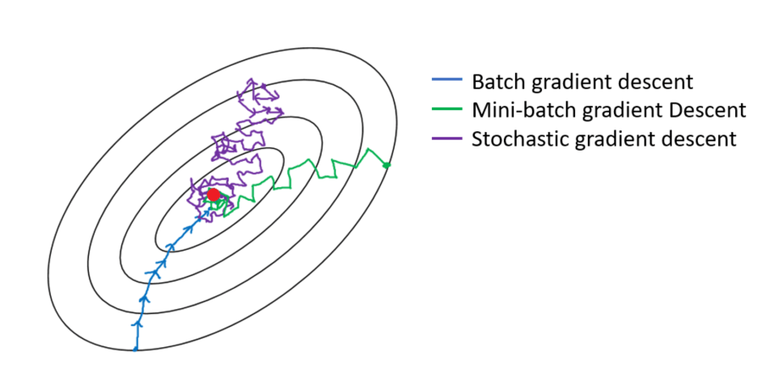









BGD vs SGD (Pesudo-code)
$$|θ_{j+1}−θ_{j}|$$
$$θ_{j+1}$$
$$θ_{j}$$
$$|θ_{j+1}−θ_{j}|$$
$$θ_{j+1}$$
$$θ_{j}$$
$$|θ_{j+1}−θ_{j}|$$
$$θ_{j+1}$$
$$θ_{j}$$

Slide 12
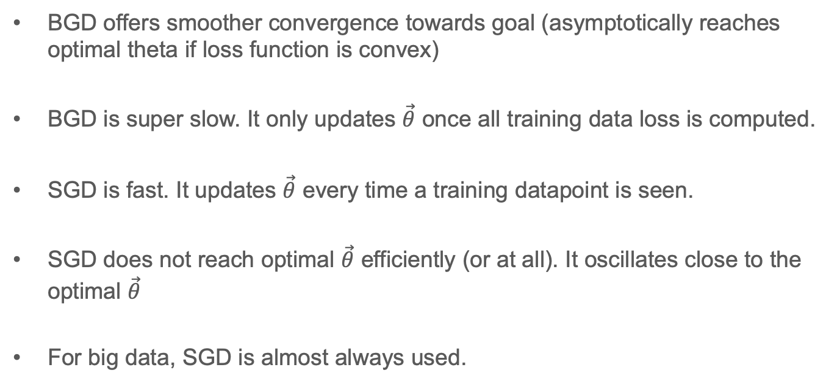
BGD vs SGD
BGD offers smoother convergence towards goal (asymptotically reaches optimal theta if loss function is convex)
BGD is super slow. It only updates $\vec{θ}$ once all training data loss is computed.
SGD is fast. It updates $\vec{θ}$ every time a training datapoint is seen.
SGD does not reach optimal $\vec{θ}$ efficiently (or at all). It oscillates close to the optimal $\vec{θ}$
For big data, SGD is almost always used.

Slide 13
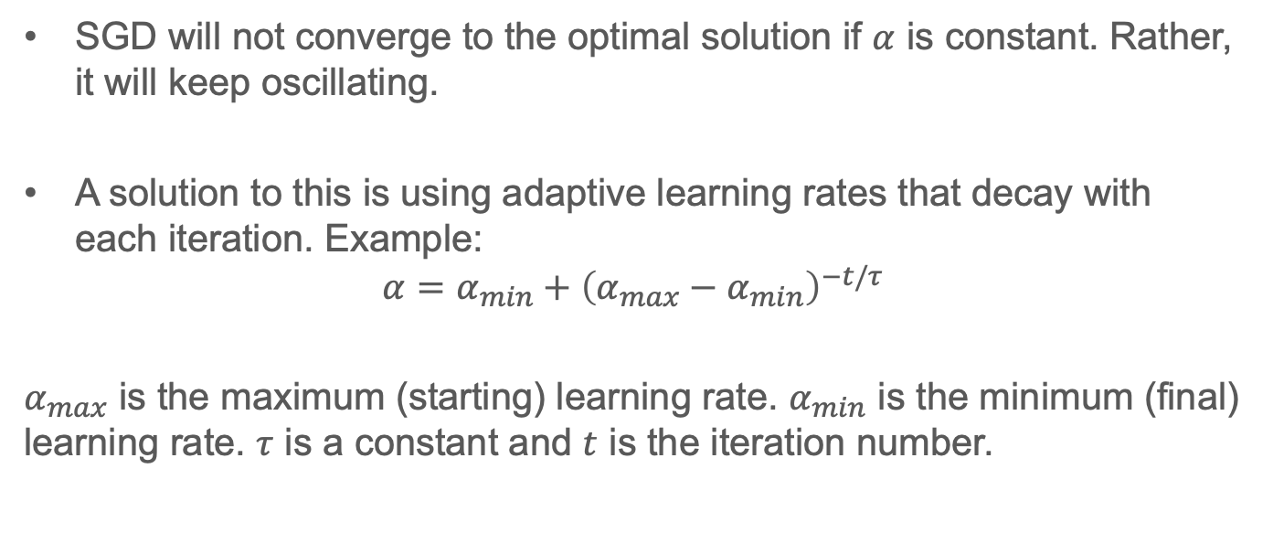
Adaptive Learning Rate
SGD will not converge to the optimal solution if $α$ is constant. Rather, it will keep oscillating.
A solution to this is using adaptive learning rates that decay with each iteration. Example:
$$α=α_{min}+{\left(α_{max}−α_{min}\right)}^{−t/τ}$$
$α_{max}$ is the maximum (starting) learning rate. $α_{min}$ is the minimum (final) learning rate. $τ$ is a constant and $t$ is the iteration number.

Slide 14
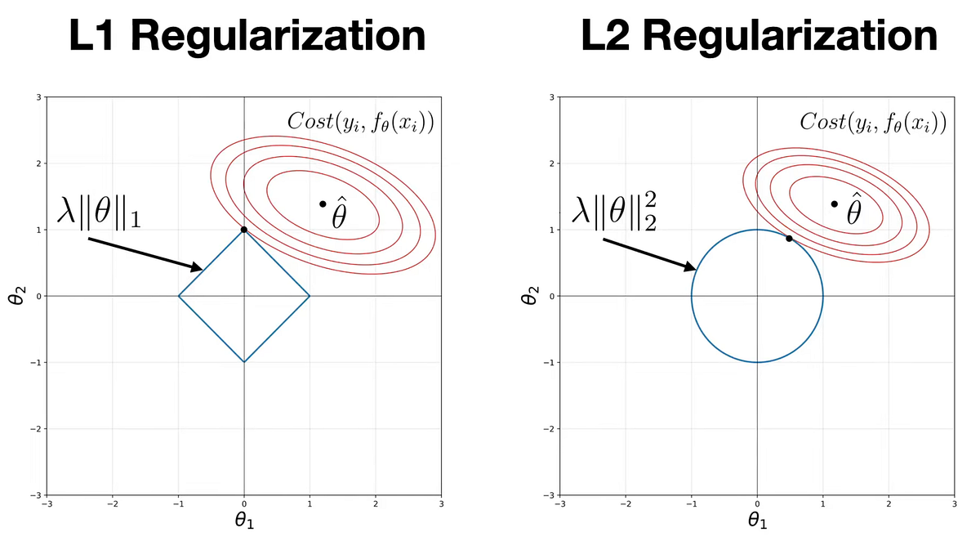
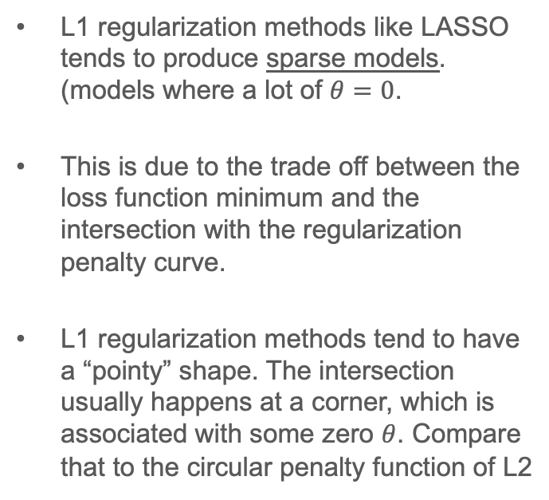
Regularization Note
L1 regularization methods like LASSO tends to produce sparse models. (models where a lot of $θ=0$.
This is due to the trade off between the loss function minimum and the intersection with the regularization penalty curve.
L1 regularization methods tend to have a “pointy” shape. The intersection usually happens at a corner, which is associated with some zero $θ$. Compare that to the circular penalty function of L2

Slide 15
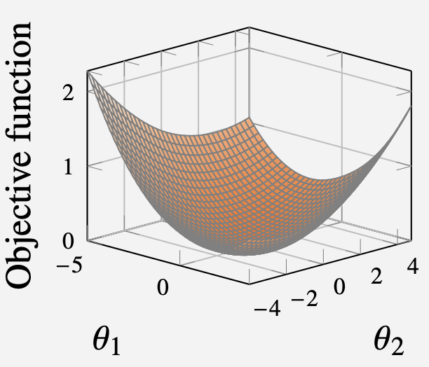
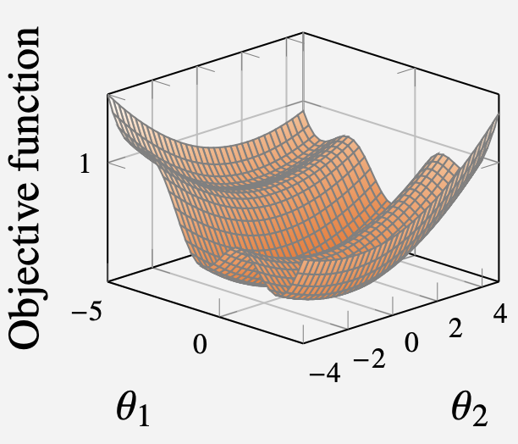
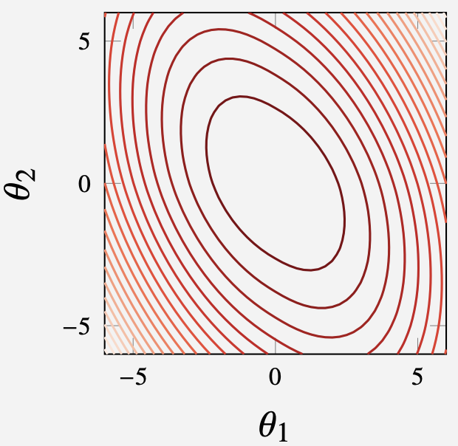
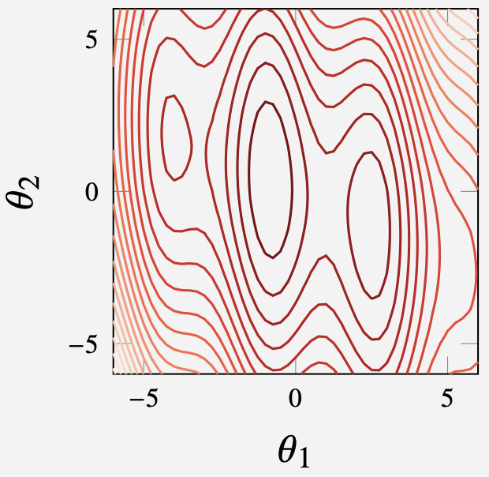

Convex Optimization vs Non-Convex Optimization
Convex functions: Functions whose shape curve down like a cup. Mathematically:
Advantage of Convex Loss Functions:
Non-convex functions:

Slide 16
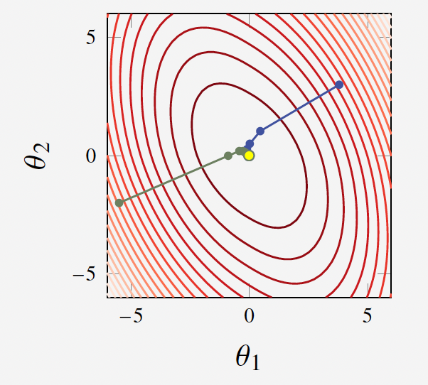
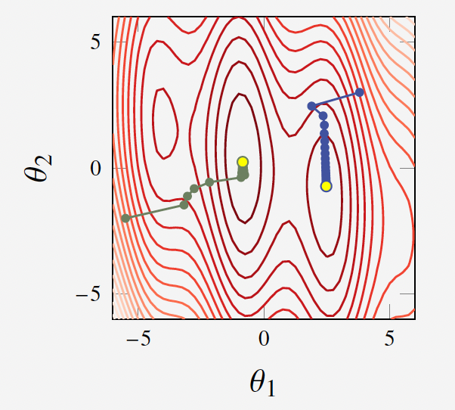
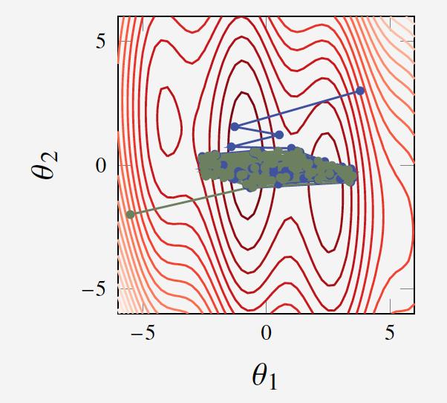
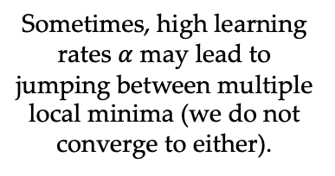
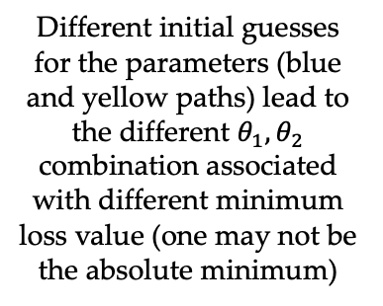
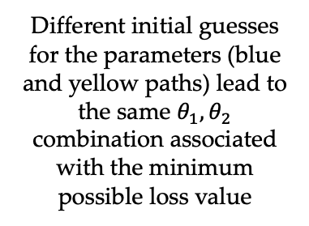
Convex Optimization vs Non-Convex Optimization
Convex Optimization
Non-convex Optimization
Different initial guesses for the parameters (blue and yellow paths) lead to the same $θ_{1}, θ_{2}$ combination associated with the minimum possible loss value
Different initial guesses for the parameters (blue and yellow paths) lead to the different $θ_{1}, θ_{2}$ combination associated with different minimum loss value (one may not be the absolute minimum)
Sometimes, high learning rates $α$ may lead to jumping between multiple local minima (we do not converge to either).

Slide 17
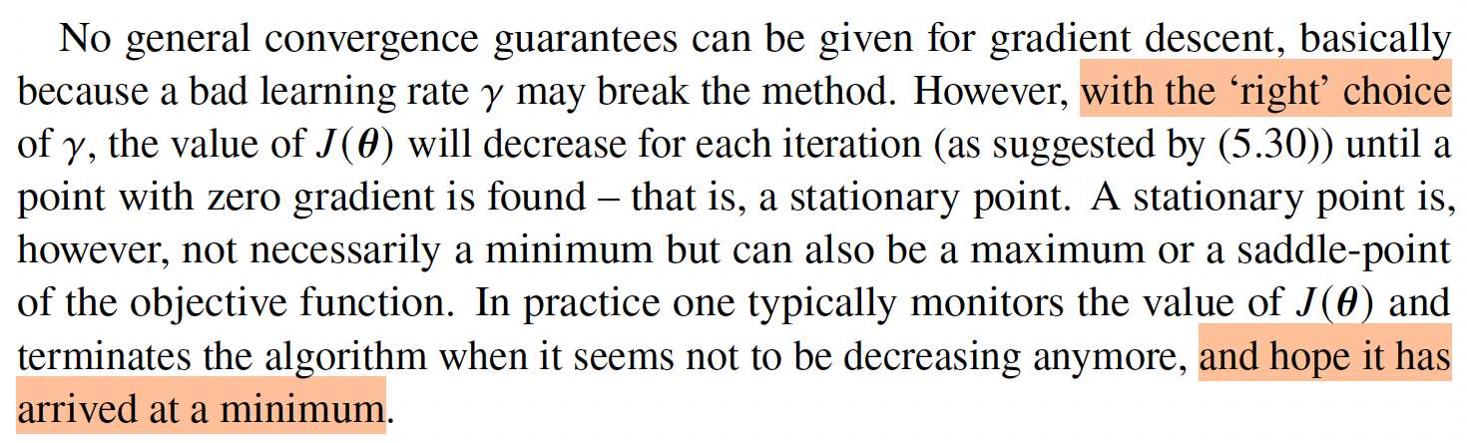
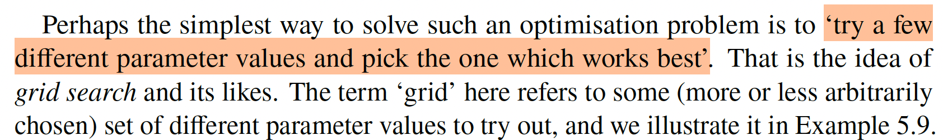
The ”Art” of Optimization

Slide 18
References
Slides (5-8) Data-Driven Science and Engineering: Machine Learning, Dynamical Systems and Control, Brunton & Kutz, second edition. Section 4.2
Materials from this slides (slide 14 – 17) used Machine Learning, A First Course for Engineers and Scientists, Lindholm et. al (March 4th, 2026 version), section 4.4 as a reference. Access to this document is free at the publishers’ GitHub page.
Materials for slides (5-13) are from: Artificial Intelligence: A Modern Approach, Russel and Norvig, 4th edition, section 19.6.2.

Slide 19
Extra notes

